Slide 1

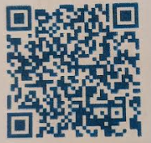



WAVES
A ministry for kids in years 3 to 6,
Register here for 2025
Term 3
WEEK 1: 25/07 | Movie Night
Week 2: 01 / 08 | Friend Filter
Week 3: 08 / 08 | Be Your Own Bestie
Week 4: 15/08 | Jesus is Your Super Friend
Week 5: 22/08 | Kindness Counts
WEEK 6: 29/08 | Games, Pizza and Sushi Night
Week 7: 05/09 | Noah's Navigation
Week 8: 12/09 | Moses' Map
Week 9: 19/09 | Jonah's Detour
Week 10: 26/09 | Travelling Mercies
WAVES friends
Contact: Mariepaz (Leng) Hazell
Mobile: 0481 507 201
Email: waves@richmondanglican.com.au
6:30 PM to 8:30 PM on Fridays
Cost- $2.00
Join our Private Facebook
page for photos and updates.

